Slide 1
The parameters
The parameters

Slide 2
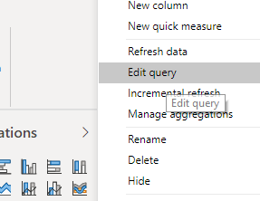
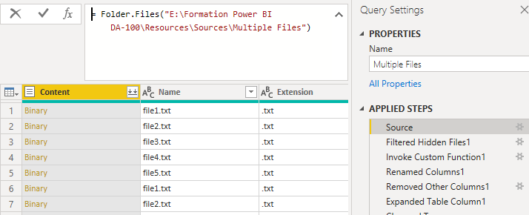
The parameters
Note: This lab uses the CSV files located in \ resources \Source Files .
Edit the imported query
Select the source, then edit the M query.

Slide 3
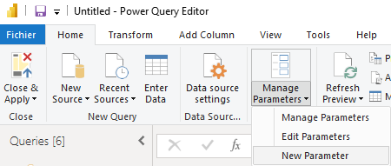
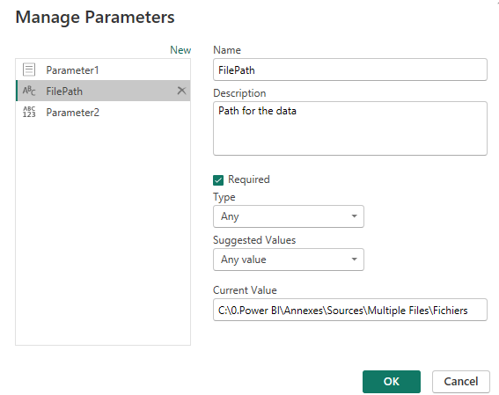
The parameters
Create a parameter named FilePath with Text as the type, and set the location of the replicated folder as the default value.
1
2
4
3
5
Note that the data remains intact without errors.

Slide 4
THANKS
THANKS

